Slide 1


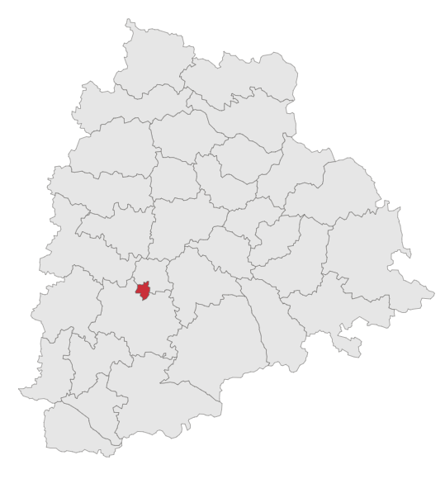
Telangana Growth Analysis

Slide 2
Index
Introduction
Document and Stamp Registration
Transportation
Telangana State Industrial Project Approval and Self-Certification System (Ts-Ipass)
Secondary Research
Conclusion and Suggestions

Slide 3
Objective
Discover insights in Stamp Registration, Transportation, and Ts-Ipass across all 33 districts.
Identify patterns and seasonal trends in all departments.
Identify growth areas and potential areas needing attention.
Identify correlations and connections among departments.

Slide 4
Project Overview
Telangana is a vibrant and diverse state located in the southern part of India.
Officially formed as India's 29th state on June 2, 2014
Home to approximately 39.96 million people
Capital city Hyderabad: Telangana has rapidly emerged as a dynamic hub for technology, culture, and commerce; where a significant portion of the urban population resides
Huge sector investments, including Real Estate, Pharmaceuticals, Agriculture, and Manufacturing

Slide 5
Stamp Registration
Stamp registration serves as legal proof of a transaction or agreement, providing evidence of its existence.
Property Deeds, Wills, Powers of Attorney, and Affidavits.
Agreements and Contracts: Rental agreements, partnership deeds, and employment contracts.
e-STAMPS: Digitization and modernization efforts to streamline the stamp registration process and reduce paperwork; catalyst COVID-19.

Slide 6
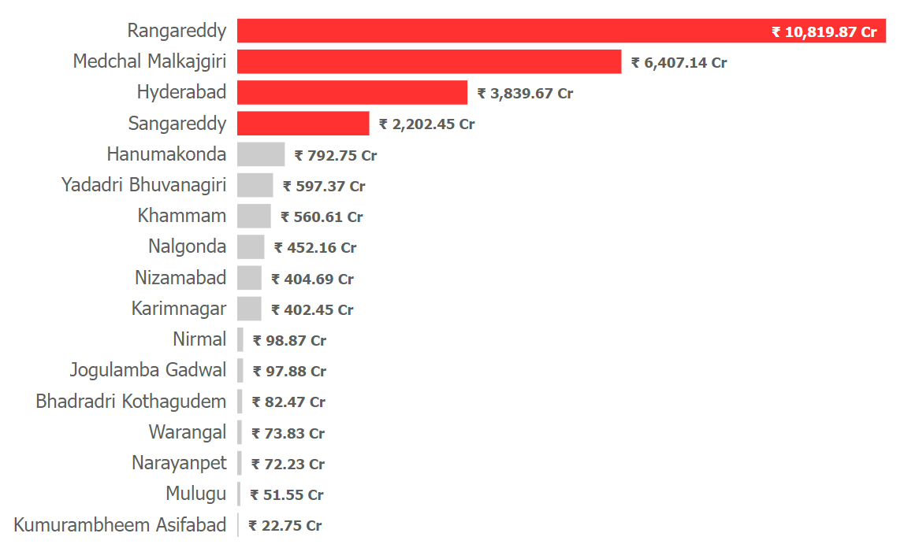
Q1
Document Registration Revenue
FY 2019 to FY 2022
Total revenue:
Rs 29,522.93 Cr
Top 4 districts: contributed 79% with only 29% population
Rangareddy’s contribution: 36.7%

Slide 7
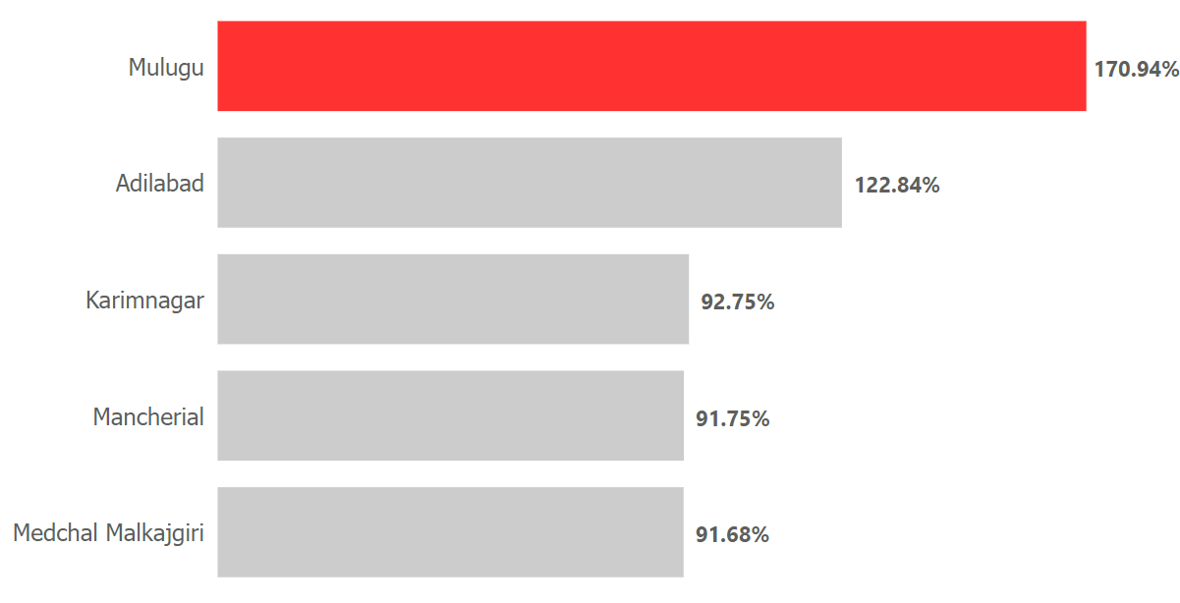
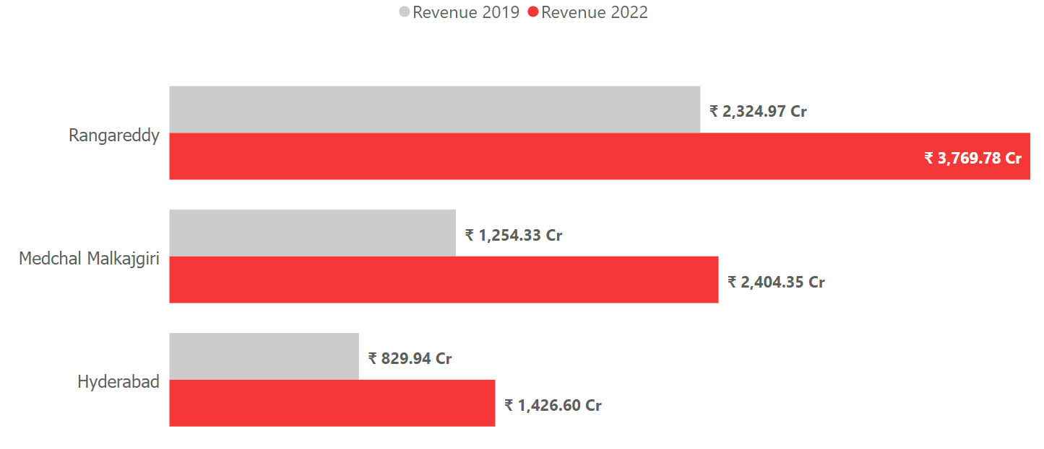
Q1
Document Registration Revenue Growth (%) from FY 2019 to FY 2022
Mulugu:
Rs 8 Cr in 2019 to Rs 21 Cr in 2022
Rangareddy:
Rs 2324 Cr (2019) to Rs 3769 Cr (2022)

Slide 8
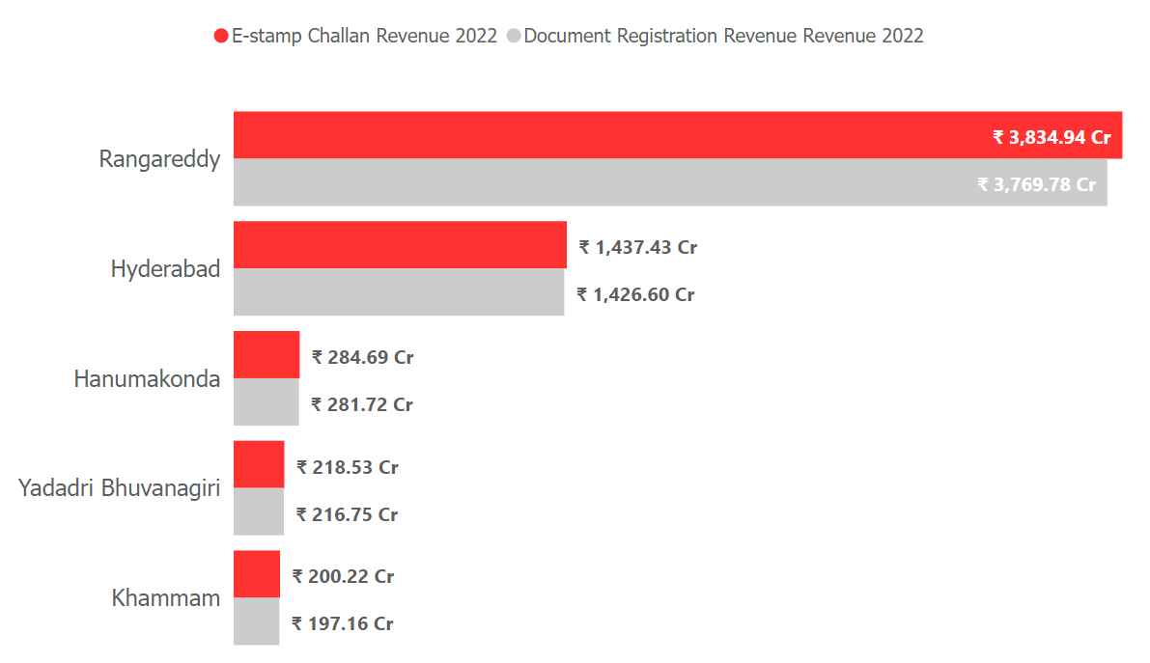
Q2
Top 5 districts that generated significantly more revenue through e-Stamps (FY 2022)
FY 2022
e-Stamp
Challan
₹ 10,715 Cr
Document Registration
₹ 10,669.54 Cr
e-stamp launched in Dec 2020
Rangareddy and Hyderabad
contribution:
71% (population 18%)
Urbanization, economic activities, digital literacy

Slide 9
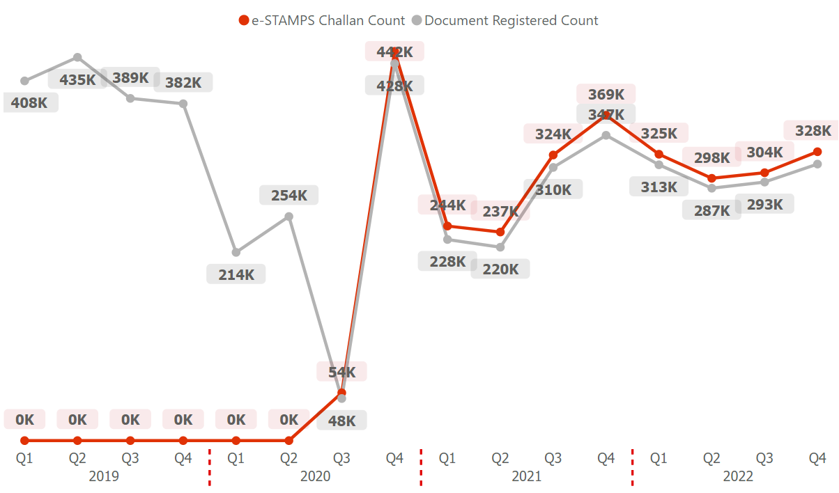
Q3
Comparison of e-STAMP Challan and Document Registered count
(FY 2019 to FY 2022)
e-Stamp launched in
Dec 2020 due to COVID-19
COVID recovery:
820% growth
Maximum registrations:
Q3 (26-28%)
Healthy adaptation of e-Stamp in urban locations:
approx. 80%
Low revenue districts contribution:
approx. 4%

Slide 10
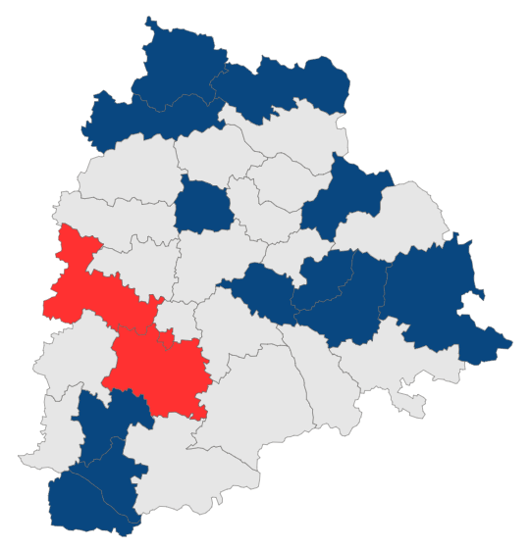
Q4
District categories based on Revenue (FY 2021-2022)
High Revenue
82%
Medium Revenue
14.5%
Low Revenue
3.5%
Total Revenue
₹ 16,974 Cr
Rangareddy
Hyderabad
Sangareddy
Medchal Malkajgiri
Hanumakonda
Yadav Bhuvanagiri
Khammam
Karimnagar
Nizamabad
Nalgonda
Mahabubnagar
Suryapet
Siddipet
Medak
Peddapalli
Mancherial
Jagtial
Vikarabad
Nagarkumool
Kamareddy
Jangaon
Rajanna Sircilla
Wanaparthy
Adilabad
Mahabubabad
Nirmal
Jogulamba Gadwal
Bhagradri Kothagudem
Warangal
Narayanpet
Mulugu
Kumurambheem Asifabad
Jayashankar Bhupalpally

Slide 11
Transportation
Vehicle Registration: Registration of new vehicles, renewal of registration, transfer of ownership, issuance of vehicle numbers, and collection of road tax.
Data of vehicle sales by their fuel type, body type, and ownership.
Generating insights on consumer trends, preferences, economic conditions, and environmental choices.

Slide 12
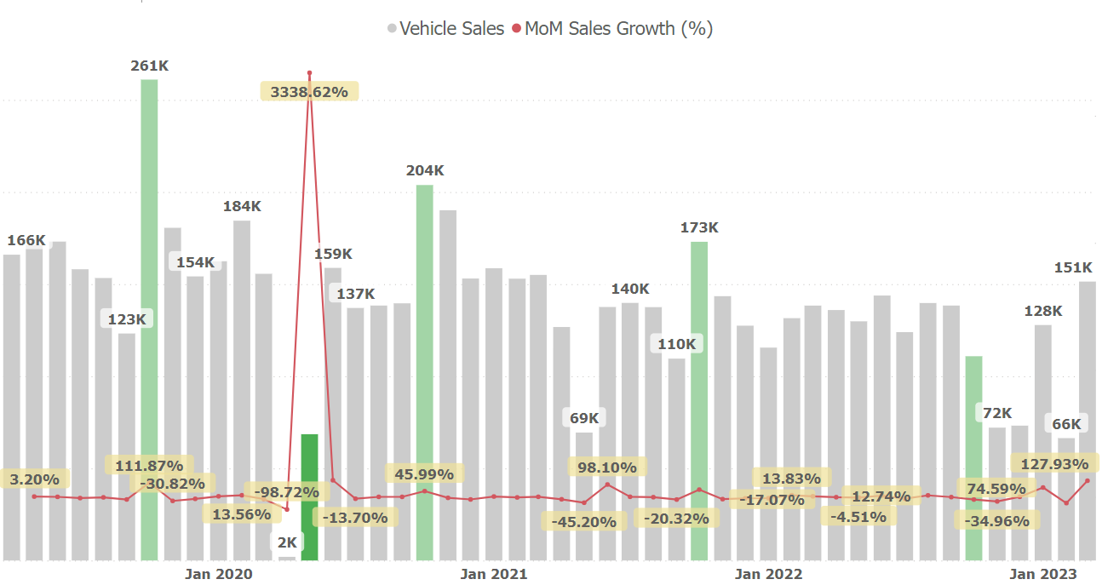
Q5
MoM Growth(%) in Vehicle Sales
COVID-19 recovery in May’20: 3338% up
October (in green): Consistent growth

Slide 13
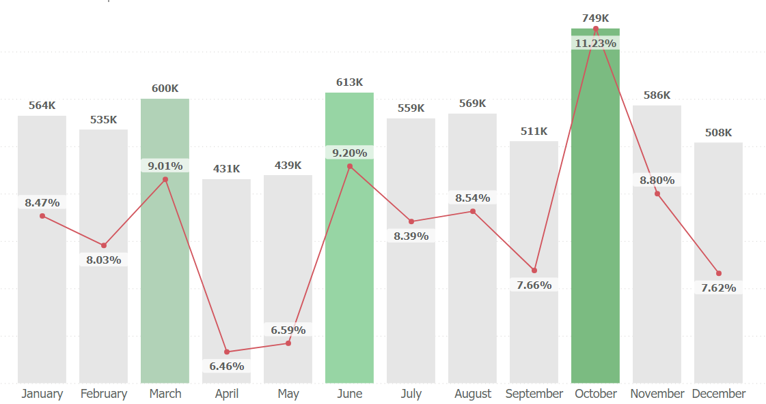
Q5
Vehicle Sales Trend by Month
October: Dhanteras
June: Launch of new models to compensate for the demand
March: Tax-saving investments, meeting targets, year-end sales

Slide 14
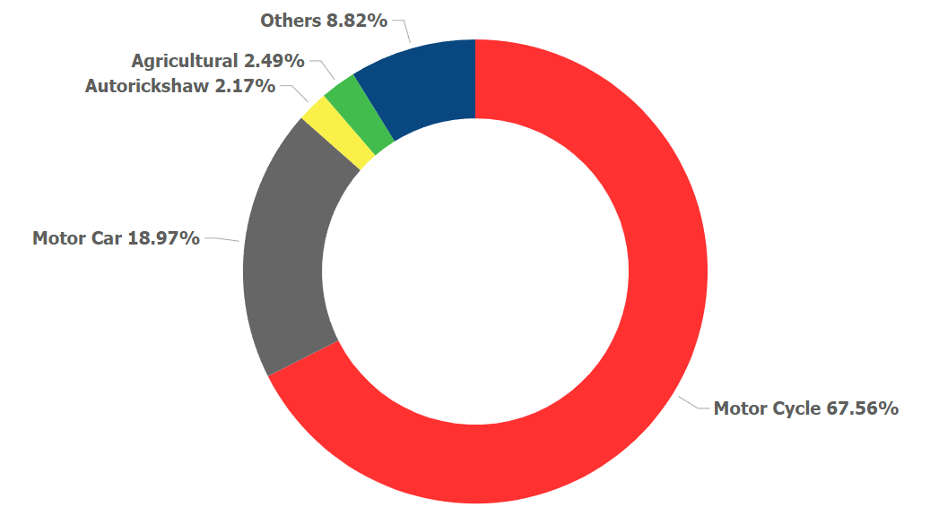
Q6
Vehicle Class Distribution across Districts for FY 2022
Motorcycle: 67.56% market share
Motorcycle share/District: 55-75%
Motor Cycle 55%: Hyderabad, Medchal Malkajgiri, Rangareddy
Motorcar 74.18%: Rangareddy, Medchal Malkajgiri, Hyderabad, Sangareddy
Agricultural 38% : Nalgonda, Siddipet, Suryapet, Khamman, Bhadradri Kothagudem, Jayashankar bupalpally
Autorickshaw 53.8%: Hyderabad, Sangareddy, Khammam, Vikarabad

Slide 15
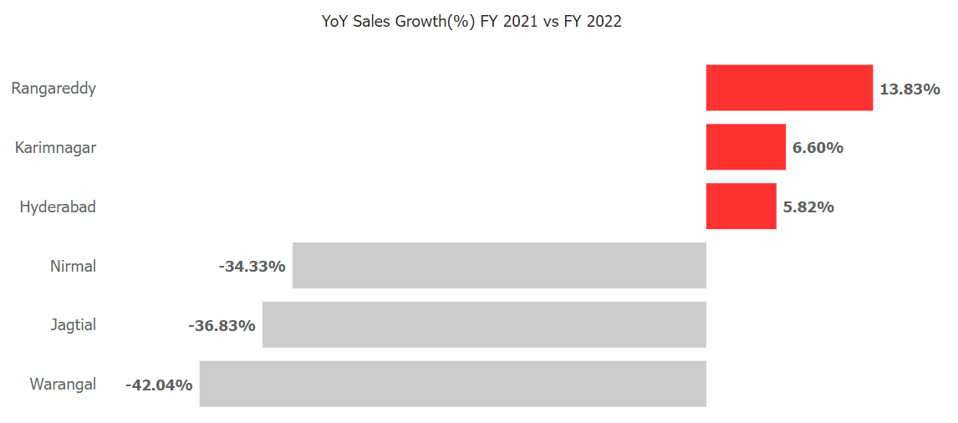
Q7
Top 3 and Bottom 3 Districts by Vehicle Sales Growth(%)
FY 2021 TO FY 2022

Slide 16
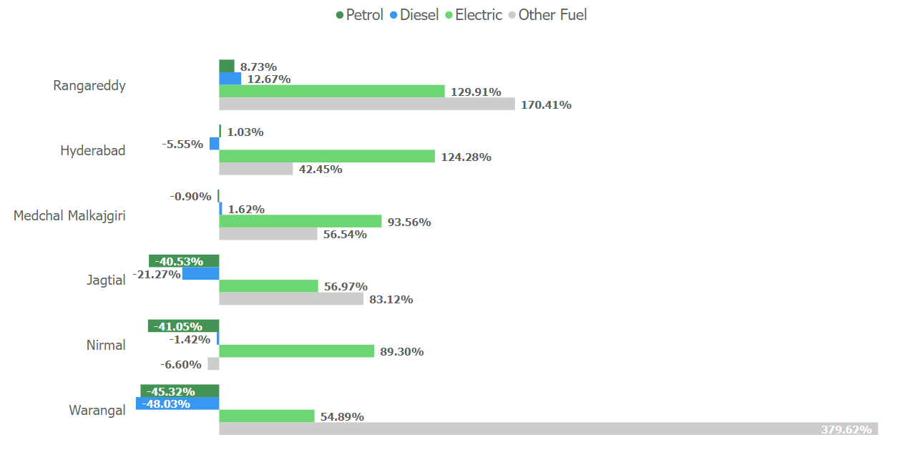
Q7
Top 3 and Bottom 3 Districts by Vehicle Sales Growth(%)
FY 2021 TO FY 2022
Positive growth of Electric vehicles and alternatives to conventional fuel.
Adoption of environment-friendly alternatives.

Slide 17
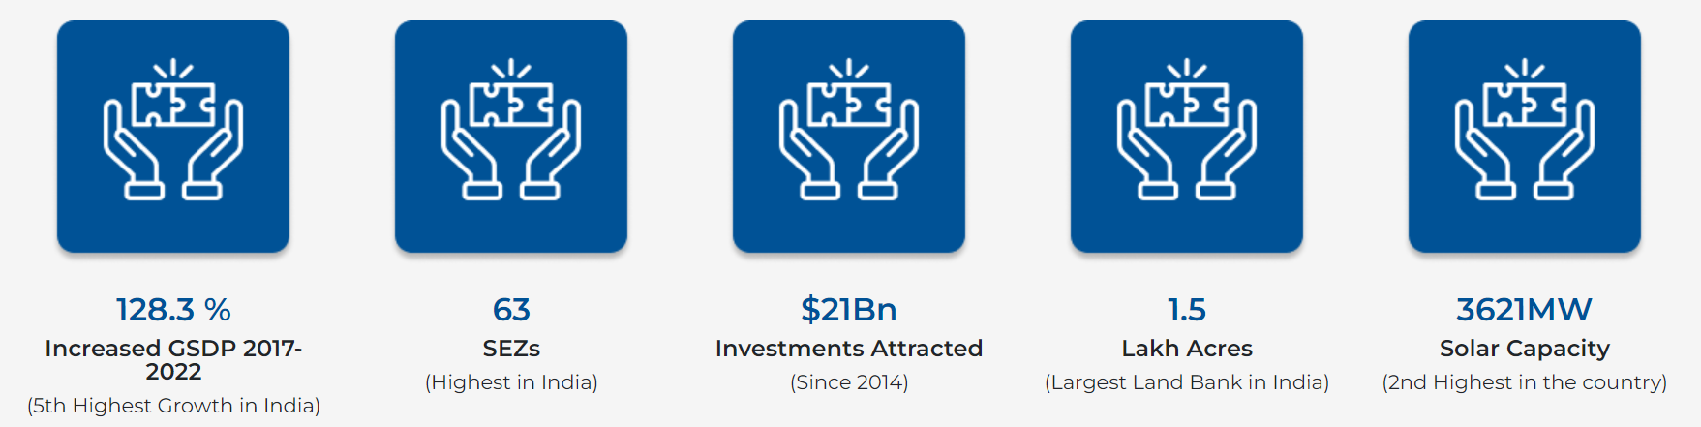
Telangana State Industrial Project Approval and Self-Certification System
(Ts-Ipass)
Designed to streamline and expedite the process of industrial project approvals.
Enhances ease of business.
Remarkably reduces the time and effort
Credits: invest.telangana.gov.in

Slide 18
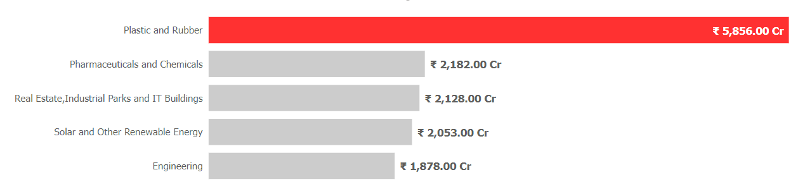
Q8
Top 5 Sector Investments in FY 2022
Top 5 sectors: 54.71%
Plastic and Rubber: 22.7%
Diverse applications across various industries: Automotive, Construction, Pharma, Packaging, and Electronics.

Slide 19
Plastic and Rubber
Q8
Telangana is one of the first states to allow engineering plastics manufacturers to set up their units In industrial parks and products they cater to.
100% FDI is allowed under the automatic route in the chemicals sector (except in the case of certain hazardous chemicals)
Central Institute for Tool Design (CITD) : catalyst for skilling in the PLASTICS sector
Solar and Other Renewable Energy
3621MW Solar Capacity (2nd highest in India)
Telangana accounts for 10.5% of India’s solar power capacity while being 3.5% of India’s land area.

Slide 20
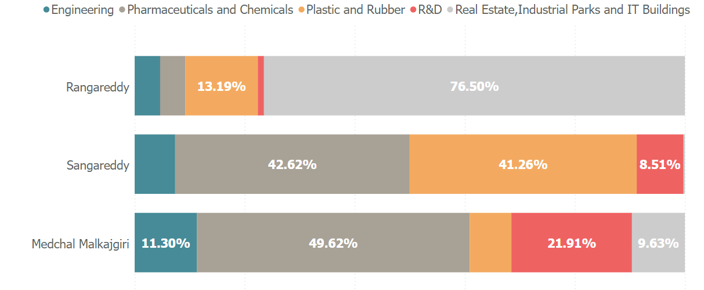
Q9
Top 3 Districts with Significant Investments
(FY 2019 to FY 2022)
Total Investment: ₹ 99,133.47 Cr
Rangareddy: ₹ 42,706.33 Cr (43.07%)
Sangareddy: ₹ 12,366.76 Cr
Medchal Malkajgiri: ₹ 10,394.56 Cr
Proximity to Hyderabad: Economic Hub
Industrial parks and special economic zones (SEZs)
Skilled and educated workforce
Developed Infrastructure and Supportive Ecosystem and Govt. policies

Slide 21
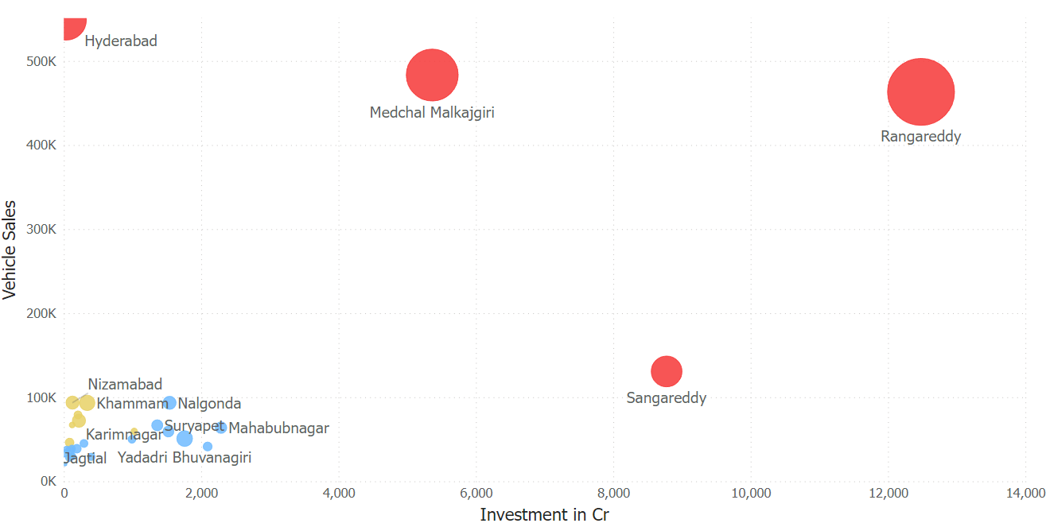
Q10
Relationship between District Investments, Vehicles Sales, and Stamps Revenue
(FY 2021 and 2022)
Positive economic growth
Economic growth and increased investments lead to more property transactions and create earning opportunities.
Consequently, higher stamp revenue for the district and higher quality of life which pushes sales.

Slide 22
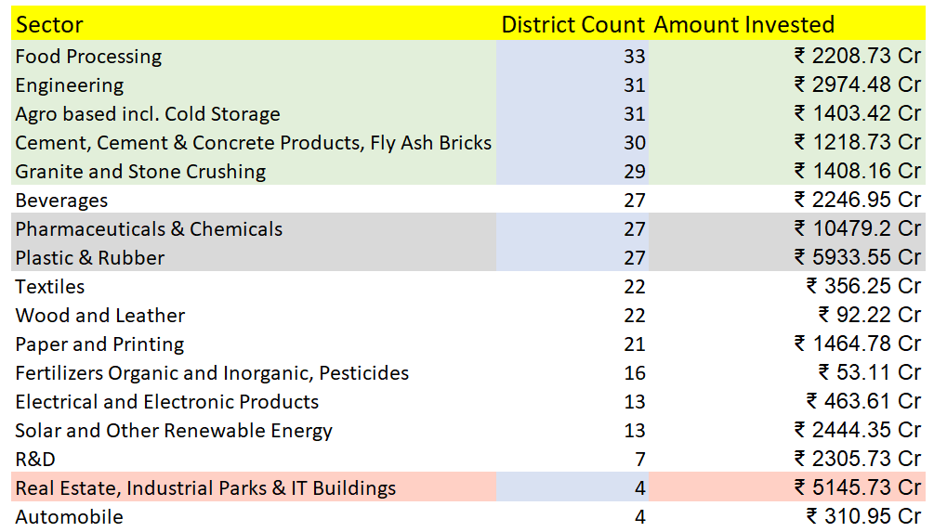
Q11
Sector-wise Investments in Multiple Districts
(FY 2021 and 2022)

Slide 23
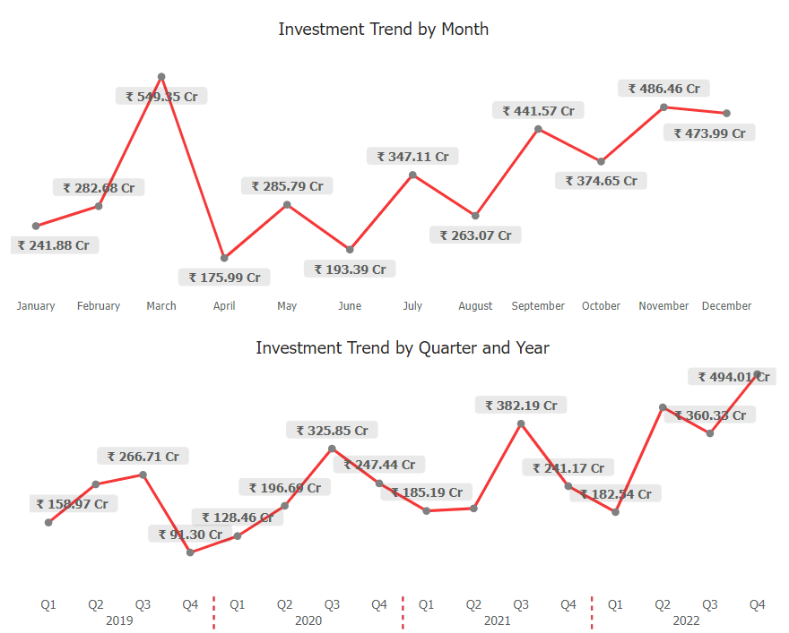
Q12
Investment Trend and Patterns
Food Processing
Highest investment: 3rd Quarter (March Rs 549.25 Cr)
Post-harvest season
Processing of perishable fruit and vegetables.
Summers: surge in demand for processed and packaged foods.
Govt. Policies: Incentivizes businesses to invest before the fiscal year-end to take advantage of tax benefits.

Slide 24
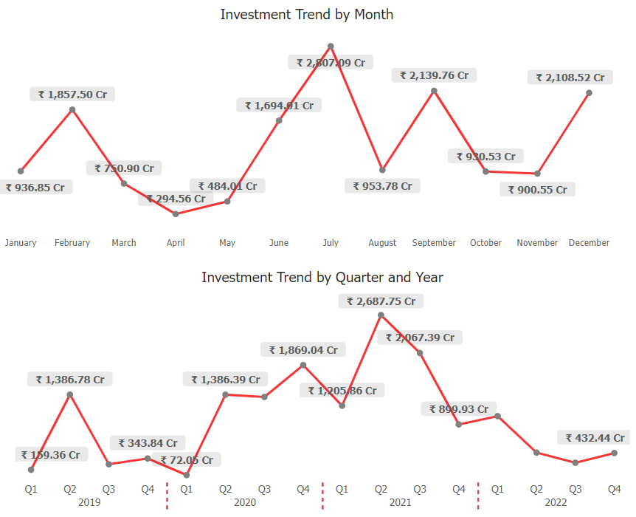
Q12
Investment Trend and Patterns
Pharmaceuticals and Chemicals
Highest investment: July
Monsoon season: July to September; maximum occurrence of diseases.
Vaccines for flu season are often produced and distributed before the onset of winter, which aligns with the third quarter.
No specific pattern

Slide 25
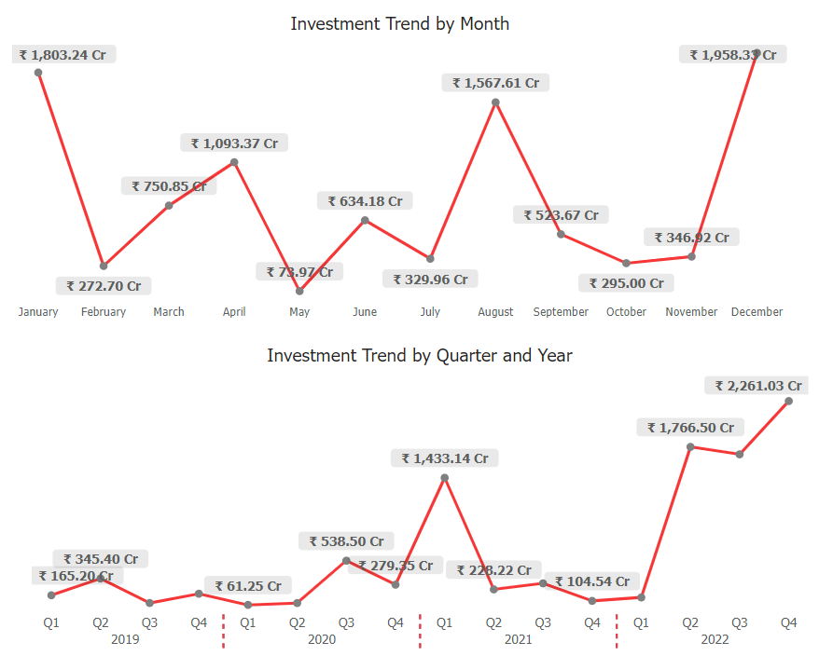
Q12
Investment Trend and Patterns
Plastic and Rubber
Cyclical pattern:
every 4 months
Seasonal demands of various industries: Automotive, Construction, Pharma, Packaging, and Electronics.
Huge demands and regular inventory management.

Slide 26
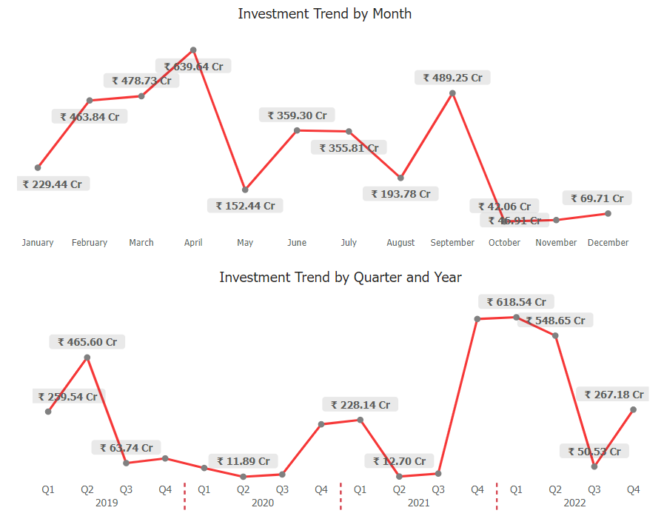
Q12
Investment Trend and Patterns
Research and Development
Highest at the start of FY And decreases with the end of FY but regularly uplifts in the 4th quarter
Riding waves
Q3 lowest investment consistently

Slide 27
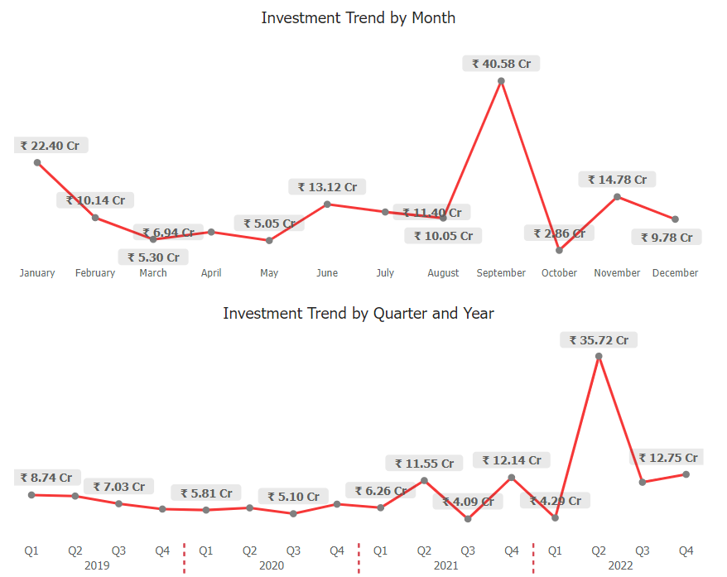
Q12
Investment Trend and Patterns
Wood and Leather
Q2 and Q4

Slide 28
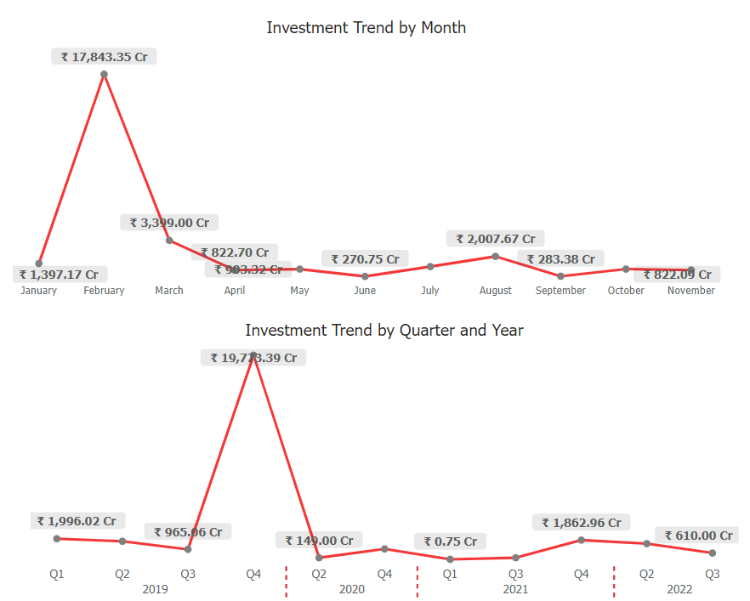
Q12
Investment Trend and Patterns
Real Estate, Industrial parks, and IT buildings
Highest: Q4

Slide 29
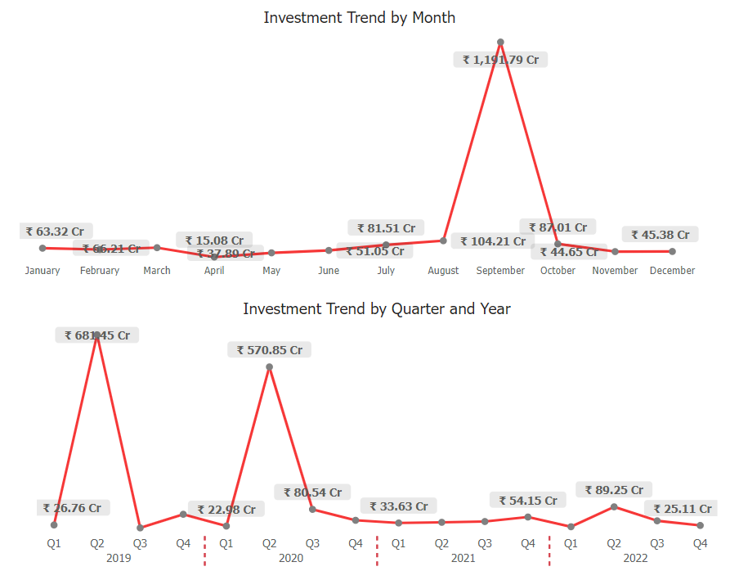
Q12
Investment Trend and Patterns
Textile
Highest: Q2

Slide 30
Additional Research &
Findings

Slide 31
Q1
Top 5 Districts to buy Commercial Properties
Real Estate investments: ₹ 29,500 Cr in Rangareddy and Medchal-Malkajgiri
IT & Financial Hubs, Co-working offices
Educational Centers, MNCs, and Research Centers
Warangal (Urban): Major commercial center for Textiles, Pharmaceuticals, Engineering, etc.
High growth in economic activities and quality of life.
Good connectivity by road and railways.
Growth in Tourism: Hyderabad and Warangal (Urban)
Rangareddy
Hyderabad
Medchal Malkajgiri
Sangareddy
Warangal (Urban)

Slide 32

Q2
Significant Government Policies and Initiatives by
Bharat Rashtra Samithi which impacted
Economic Growth, Investments and Employment
(2018-2023)
Sources:
Economic Development of Telangana @Ten
Telangana Socio-Economic Outlook 2023
Economic growth:
Telangana's GSDP @12% per year since 2018
National average growth rate of 7.5% per year.
Investments: ₹4 lakh crore
Employments: 10 lakh jobs
Unemployment rate: Fallen from 8% in 2018 to 6% in 2023

Slide 33
Q2
Significant Government Policies and Initiatives by
Bharat Rashtra Samithi which impacted
Economic Growth, Investments and Employment
(2018-2023)
A. Startup Telangana
Supported over 3,500 startups
Jobs: 35k
Made Telangana one of the leading startup hubs in India
B. TS-iPASS & TS-bPASS
Investments: ₹4 lakh crore
Employment: 10 lakh
Reduced the time taken to set up a business in Telangana by up to 75%

Slide 34
Q2
Significant Government Policies and Initiatives by
Bharat Rashtra Samithi which impacted
Economic Growth, Investments and Employment
(2018-2023)
C. Rythu Bandhu
Helped to increase agricultural production by 25%
Increased farmer income by 35%
Improved the standard of living for farmers in Telangana
D. Mission Kakatiya
Restored over 48,000 irrigation tanks and lakes
Benefited over 12 lakh farmers
Increased the area under irrigation by 15%
Improved agricultural productivity and income in Telangana

Slide 35
Q3
Insights & Recommendations
Urbanization but not at the cost of Nature
Digitization and modernization and infrastructure development in medium and low-revenue group districts
Parallely Setting up recycling units in medium and low revenue generating districts while there’s an increase in investment in plastic and rubber industries; increase in jobs, preserving state of catastrophic effects of pollution like in delhi.
Increase in agriculture
Skilling workforce in medium and low revenue group districts: familiar with agriculture
Invest in solar and renewable energy sources to fuel industries
Invest in R&D; focus on finding
Promote electric vehicles and use of alternative fuels
Promote tourism: increase in sales of adventure bikes, revenue generation

Slide 36
Q3
Insights & Recommendations
“Urbanization but with Nature”
Invest in infrastructure development:
Infrastructure deficit: ₹2 lakh crore (2023), according to TSIDC.
Expected to increase to ₹4 lakh crore by 2030
Invest in medium and low-revenue-generating districts
Create jobs, boost economic activity, attract more investors, and
reduce citizen disparity between Urban and Rural regions
Sector Investments:
Focus on Solar and Renewable energy, Agriculture, and R&D
Setting up Recycling Units parallel to the Plastic and Rubber industries

Slide 37
Q3
Insights & Recommendations
“Urbanization but with Nature”
Upskilling workforce:
According to TSSSDC, the state has over 100 skill development centers that train over 1 lakh youth every year.
Promote entrepreneurship and innovation:
among the top five startup hubs in India.
Telangana Startup Ecosystem Report 2023, the state has over 3,500 startups that have created over 35,000 jobs
providing financial assistance to startups, incubating and accelerating them, and creating a supportive ecosystem for innovation

Slide 38
Q3
Insights & Recommendations
“Urbanization but with Nature”
Focus on sustainable development:
According to TSREDCO 5 GW of renewable energy capacity installed
Needs to be further increased to meet growing demands
Ensure its long-term prosperity

Slide 39
Thankyou
Contact details:
E-mail: siddhi.atwork@gmail.com
LinkedIn: www.linkedin.com/in/djangomustang

